Slide 1

DATA ANALYTICS Unit 3 Project 3
Furhan Babar
Mary GraCe Boyd

Slide 2
Project Objectives:
DATA BACKGROUND: Identify objectives and stakeholders
DATA ACQUISITION: Collect raw data
DATA WRANGLING: Create formalized data set through data wrangling
DATA ANALYSIS: Explore and analyze data set
CONCLUSION: Provide conclusion

Slide 3


Slide 4
Research Questions
Community acquired vs hospital
acquired
Age correlation with infection rate
Correlation between age, gender and
patient service department
Correlation between age, month,
and year
Length of stay
Lab related information
Positive cases by zip code
Number of patients by date
Patients by gender
Number of cases by month

Slide 5
Data Gathering
The data set was compiled to be submitted to the NYCHHC Central Office. Central office collects all COVID-19 data from all facilities to aggregate data for the state health department and the community.
The raw data included in this data set included all COVID-19 positive cases in Harlem Hospital since the beginning of 2020.
Raw Data Information
36 columns | 839 rows
Mixed data types (string, integer, float)
Some columns with inconsistent data
Redundant information within columns
Year range of admission (2018-2020)
Primarily COVID 19 positive cases
No negative or PUI cases

Slide 6
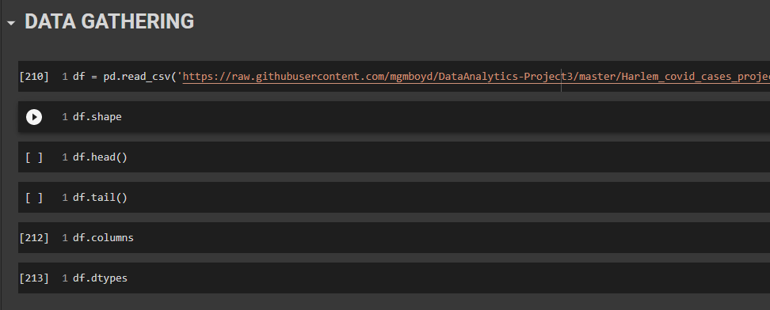
Data Gathering

Slide 7
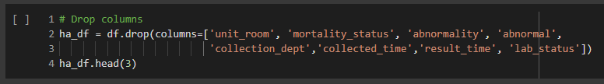

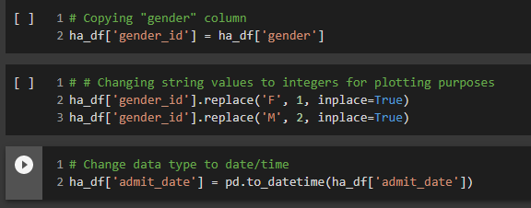
Data Wrangling
Due to redundant and unnecessary information, some columns were dropped
Columns were also added to properly aggregate the data
Some data types were changed to ensure appropriate data analysis

Slide 8
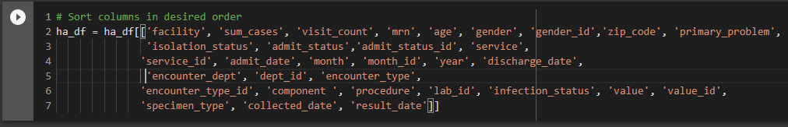


Data Wrangling
Columns were sorted intended for easy viewing and analysis
Columns were also added to properly aggregate the data
Data were sorted by admit date
Unique values for some columns were obtained for data analysis

Slide 9

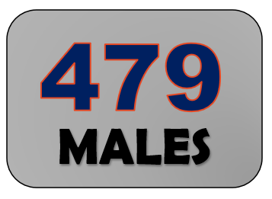





Slide 10
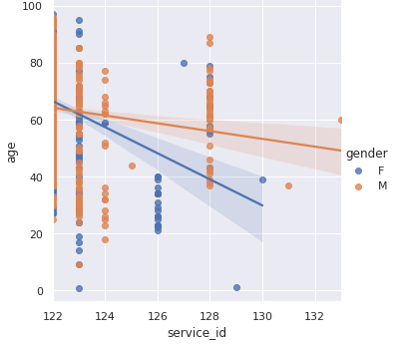
Regression Analysis
Correlation between age, gender and patient service department

Slide 11
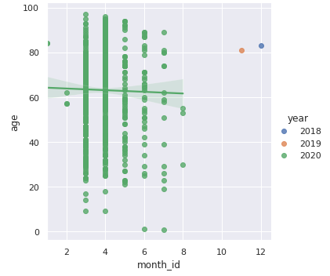
Regression Analysis

Slide 12
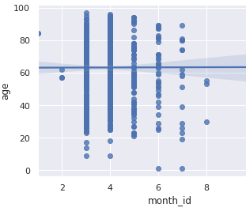
Regression Analysis

Slide 13
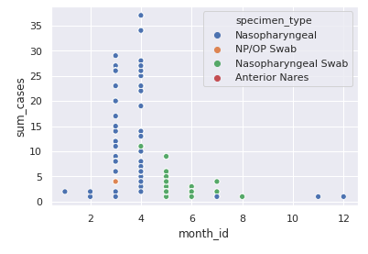
Regression Analysis

Slide 14
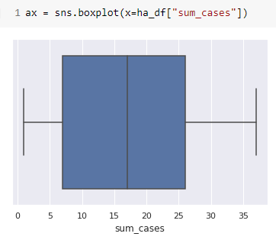

Slide 15
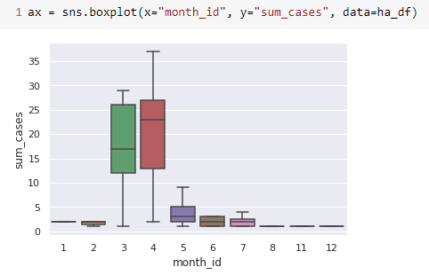

Slide 16
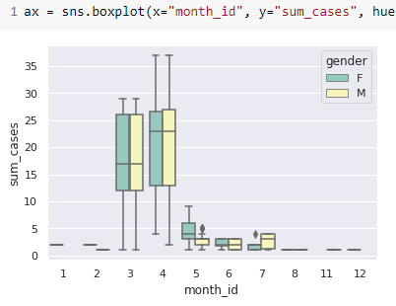

Slide 17
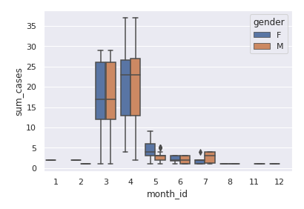

Slide 18
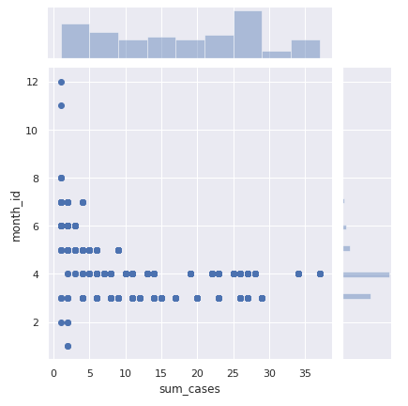

Slide 19
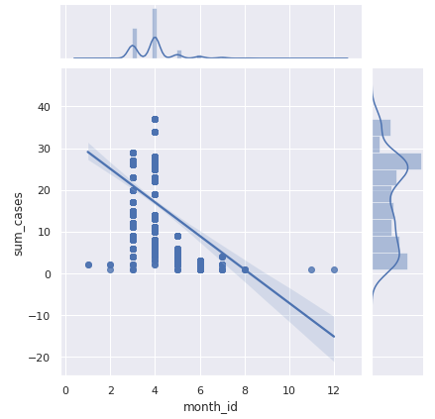

Slide 20
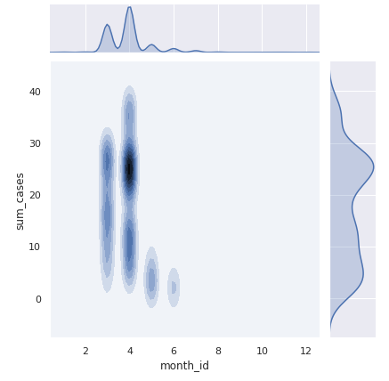

Slide 21
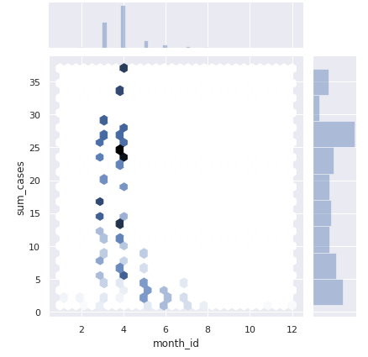

Slide 22
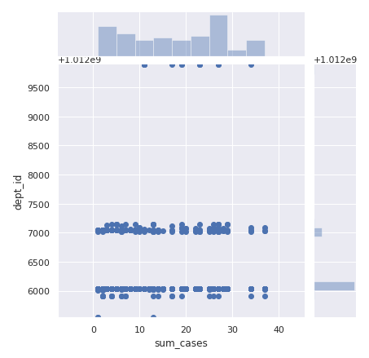

Slide 23
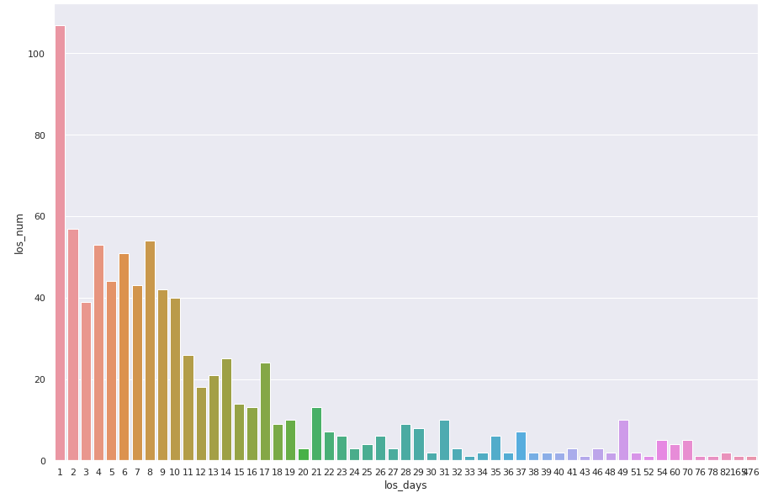

Slide 24
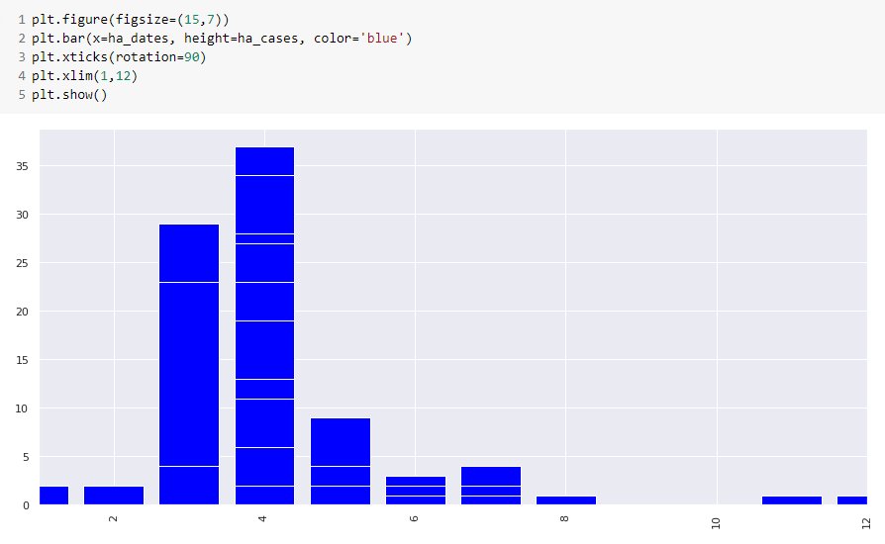

Slide 25
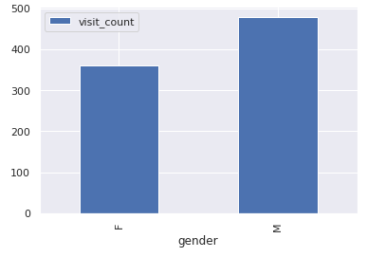

Slide 26
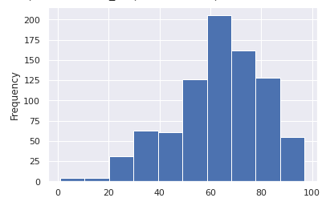
AGE

Slide 27
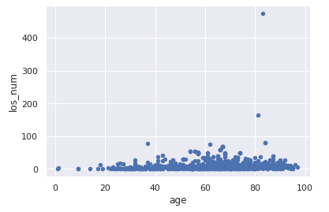

Slide 28
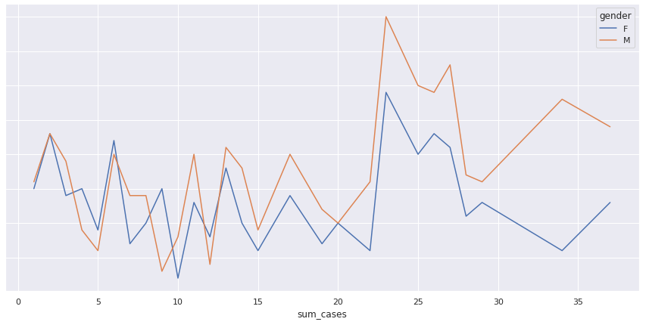

Slide 29
Conclusion
Provide the answers to the questions

